Slide 1
Network Intrusion Detection Using Machine Learning Techniques
Ashutosh Arora
Aditya Phisake
Shubham Abhale
Anuraag Ajaykummar
Under the guidance
Prof. Mr. Mayur Chavan

Slide 2
INDEX
Index
Abstract
Introduction
Literature review
About Dataset
Attack Types
Breakdown of the Classes
Objectives
System requirement specification
Classifiers Used
Feature Selection
Feature Importance
Work Flow
Confusion Matrix
Output
Future Scope
References
2

Slide 3
Abstract
  Network security has become one of today's most urgent social problems. Intrusion detection and prevention is becoming the greatest problem in the field of network security with the rise of hacking and leveraging instruments and the development of new ways of intrusion.
  Various techniques are being used in intrusion detections, but sadly all of the systems so far are not fully flawless.
  Intrusion detection systems using data mining techniques make it possible to scan patterns and rules in a vast number of audit data. Classification-based data mining models for intrusion detection are often unsuccessful in resolving complex shifts in intrusion patterns and characteristics.
3

Slide 4
Abstract
We have used different Classification methods for the identification of network intrusions. We conducted our clustering algorithm experiments and calculated the results based on detection rates and false positive rates with various cluster values.
Using machine learning method, our intrusion detection system is able to detect various types of intrusions while maintaining a low false positive rate
4

Slide 5
Introduction
Given the various types of attacks, such as Denial of Service, Spoofing, Session hijacking, Password Guessing, and others, detecting a wide range of attacks is a challenge for any intrusion prevention device.
The purpose of intrusion prevention systems is to detect attacks from the stream of network audit trails automatically.
Due to the ineffectiveness of the signature methods for intrusion detection the approach we have looked forward to is Data Mining and Machine Learning.
An approach which, when the training data set is unlabeled, can identify the records. Unsupervised methods of learning presume that there is no mark for training results. The comparative study has been conducted to determine the best classification algorithm used.
5

Slide 6
Introduction
Our classification model draws conclusion from the input values given for training. It will predict the class labels/categories for the new data.
Our technique is to create and compare a probabilistic model from the training data and then use it to assess whether or not a new record is an anomaly.
6

Slide 7
Literature Review
Intrusion threatens, in terms of availability, honesty and confidentiality, the protection of communication networks. An attacker may be an insider or an outsider attempting to gain unauthorized control and entry of a device.
Intrusion detection systems focused on anomalies presume that all intrusive behaviours are anomalous, which may lead to activities that are anomalous but not intrusive, therefore being mistakenly recorded as intrusive. This is called a false positive.
[1] focus on detailed study on NSL- KDD dataset that contains only selected record. This selected dataset provide a good analysis on various machine learning techniques for intrusion detection.
7

Slide 8
Literature Review
A Detailed study of anomaly detection schemes in network intrusion was conducted by Lazarevic, A., Ertoz, L., Kumar, V., Ozgur,. A., Srivastava in [2].
Various classification machine learning algorithm were compared on the basis of their basic logic, advantages, disadvantages, assumptions, effects of co-linearity & outliers, hyper-parameters, mutual comparisons in [4].
To function on network intrusion data, the KNN classification is proposed and the algorithm is tested with the KDD99 dataset and satisfactory results are found after the comparative analysis.
8

Slide 9
About Dataset: NSL – KDD Dataset
These data sets contain the records of the internet traffic seen by a simple intrusion detection network and are the ghosts of the traffic encountered by a real IDS and just the traces of its existence remains.
The data set contains 43 features per record, with 41 of the features referring to the traffic input itself and the last two are labels (whether it is a normal or attack) and Score (the severity of the traffic input itself).

Slide 10
Attack Types
DoS is an attack that tries to shut down traffic flow to and from the target system.
Probe or surveillance is an attack that tries to get information from a network.
U2R is an attack that starts off with a normal user account and tries to gain access to the system or network, as a super-user (root).
R2L is an attack that tries to gain local access to a remote machine.

Slide 11
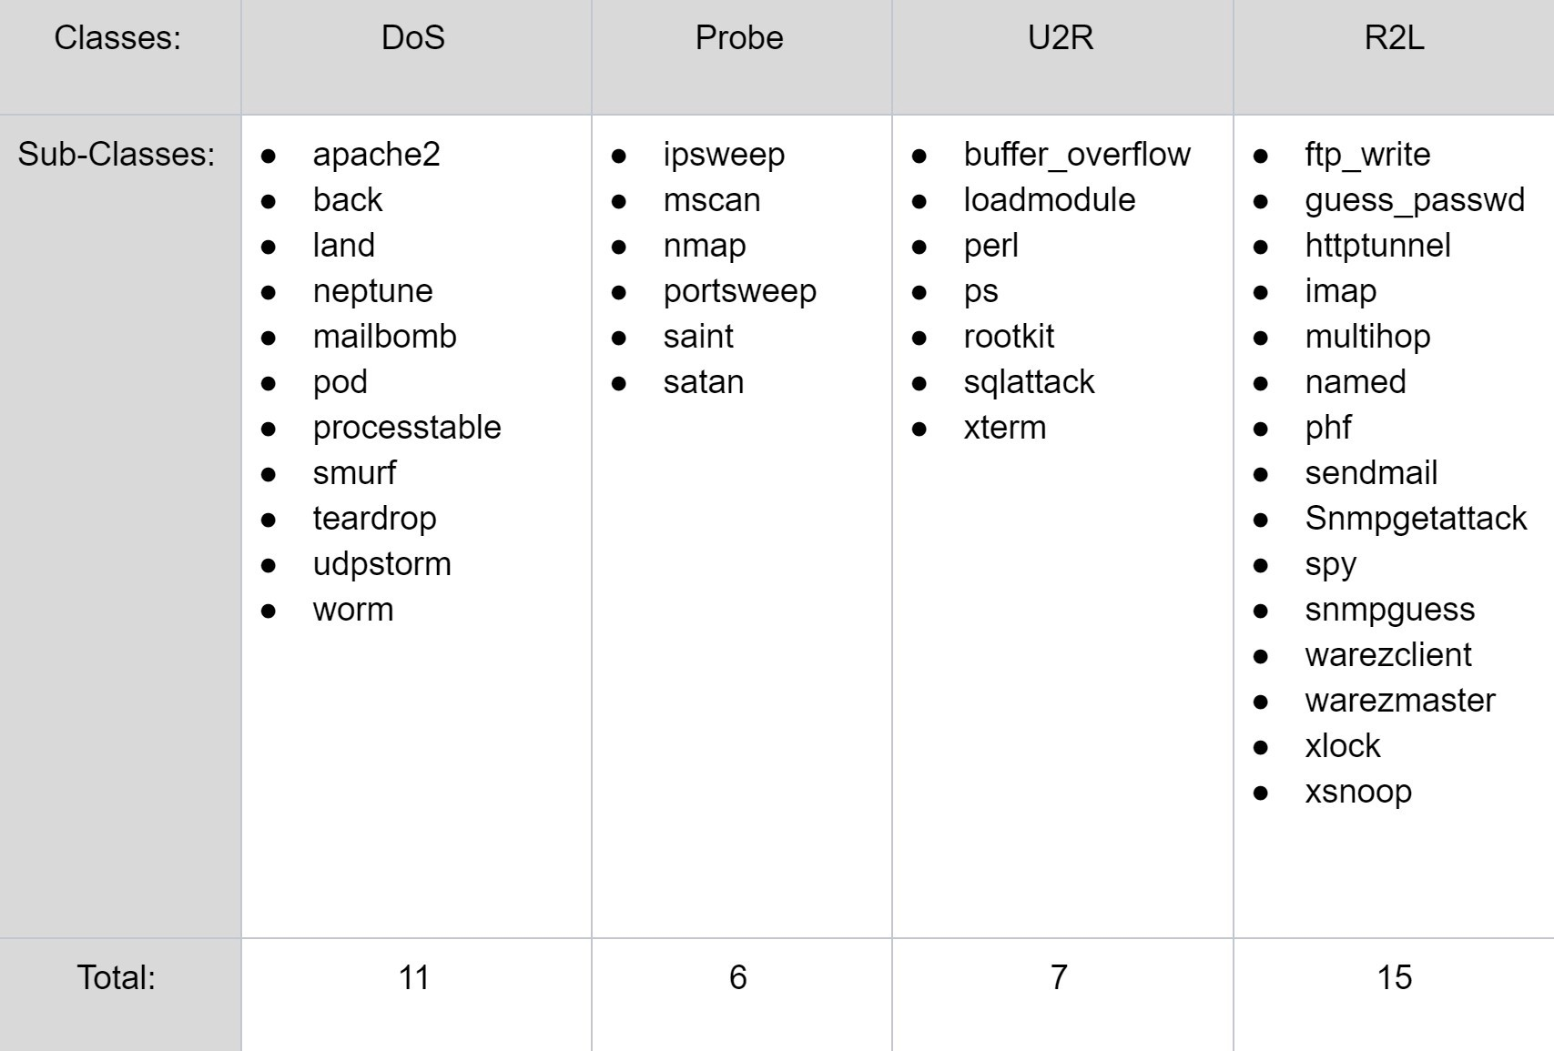
Breakdown Of The Classes

Slide 12
Objectives
● To detect the intrusion attacks to prevent systems from various attacks and damages.
● Make a robust and efficient system by experimenting with various techniques.
● To pre-process the raw data and make it suitable for Machine learning by applying techniques in NLP such as lemmatization and stemming and perform feature selection using Random forest algorithm.
● To implement Naïve Bayes classifier, Decision Tree classifier, KNN and Logistic regression algorithms to detect various intrusion attacks like DOS, U2R, R2L, Probe.
12

Slide 13
Objectives
● To detect the accuracy and enhance the efficiency by using various algorithm enhancement techniques.
● Output the model results using the KDD dataset and tabulate the results and evaluate its performance in terms of false positive and false negative rate, recall, precision and overall accuracy.
13

Slide 14
System requirement specification
1. Hardware Requirements
• Free Memory on HDD: At-least 2 GB
• Memory: 2 GB • Processor: 2.5+ GHz processor or higher
2. Software Requirements: • Operating System: Windows 8 or higher version of Windows / Ubuntu 18.04 or higher • Programming Environment: Python 3
3. Developer Tools:
• Python3 IDE like Visual Studio or PyCharm or Jupyter Notebook
• NLTK (Natural Language Toolkit)
• Deep learning libraries and Scikit Learn libraries
• NumPy • SciPy • Pandas • TensorFlow • Matplotlib
14

Slide 15
Classifiers Used
Naïve Bayes
Decision Tree
KNN
Logistic Regression

Slide 16
Feature Selection
Random Forest Algorithm:
Feature selection using Random forest comes under the category of Embedded methods. Embedded methods combine the qualities of filter and wrapper methods.
They are implemented by algorithms that have their own built-in feature selection methods. Some of the benefits of embedded methods are :
  They are highly accurate.
  They generalize better.
  They are interpretable
16

Slide 17
Random forests consist of 4 –12 hundred decision trees, each of them built over a random extraction of the observations from the dataset and a random extraction of the features.
Not every tree sees all the features or all the observations, and this guarantees that the trees are de-correlated and therefore less prone to over-fitting.
Each tree is also a sequence of yes-no questions based on a single or combination of features.
At each node (this is at each question), the three divides the dataset into 2 buckets, each of them hosting observations that are more similar among themselves and different from the ones in the other bucket.
Therefore, the importance of each feature is derived from how “pure” each of the buckets is.

Slide 18
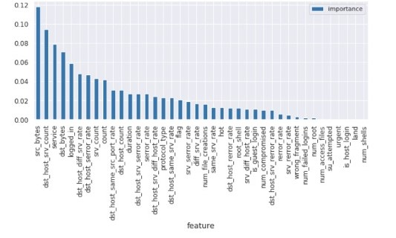
Feature Importance

Slide 19
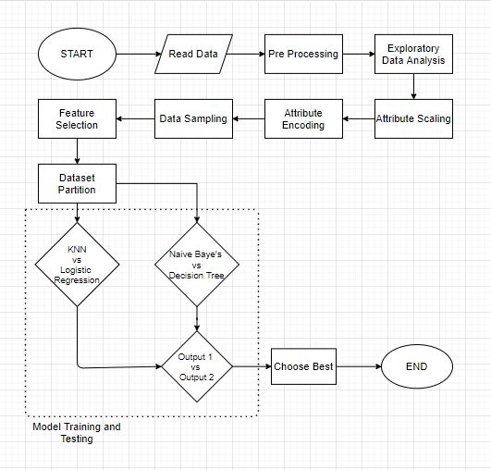
Work Flow

Slide 20
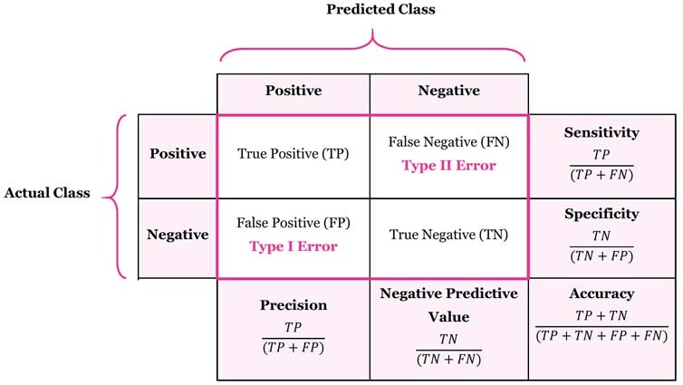
Confusion Matrix
Performance Metrics: In order to check performance, the various metrics used are given as follows:
1. Detection Rate (DR)
2. False Alarm Rate (FAR)
3. False Positive (FP)
4. False Negative (FN)
5. True Positive (TP)
6. True Negative (TN)
20

Slide 21
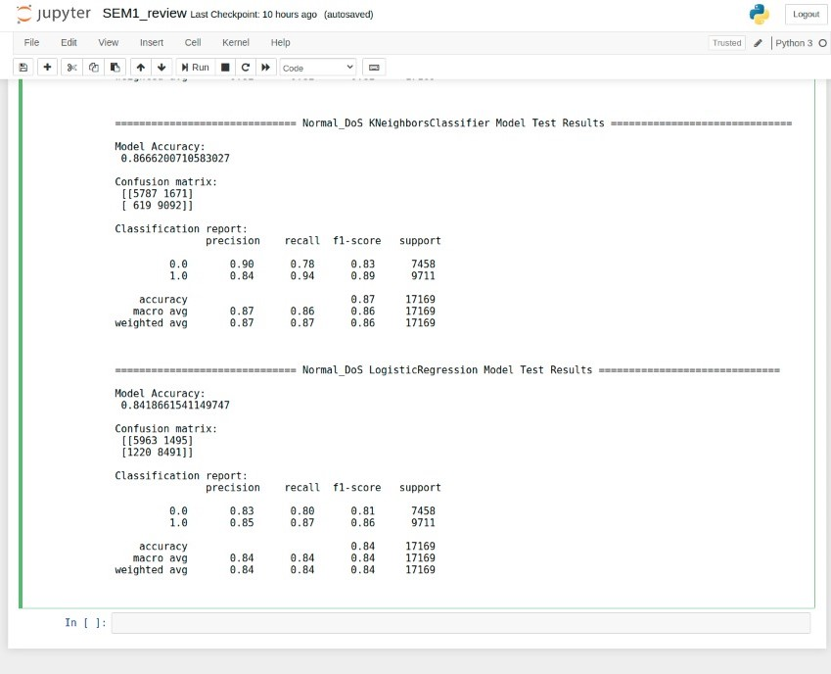
Output

Slide 22
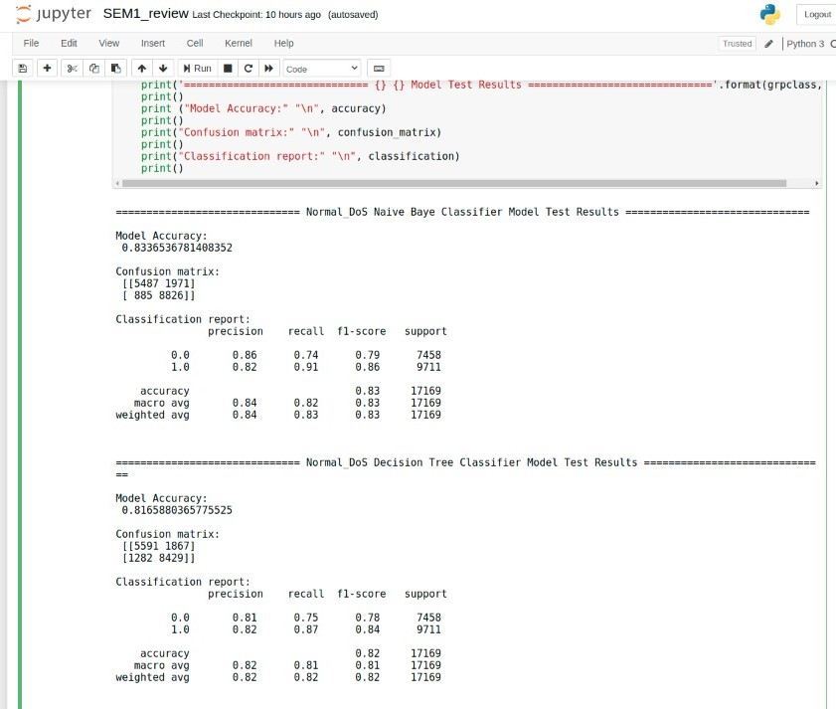

Slide 23
Future Scope
We need to build classification models for other classes of attacks which are R2L, Probe, U2R.
We can also try to improve the model by selecting different number of features from feature selection.
We can make the model more User friendly.

Slide 24
References
S. Revathi , Dr. A. Malathi “ A Detailed Analysis on NSL-KDD Dataset Using Various Machine Learning Techniques for Intrusion Detection “. International Journal of Engineering Research & Technology (IJERT)
ISSN: 2278-0181 Vol. 2 Issue 12, December - 2013
2. Lazarevic, A., Ertoz, L., Kumar, V., Ozgur,. A., Srivastava, and J., “A comparative study of anomaly detection schemes in network intrusion” International Journal of Network Security & Its Applications (IJNSA), Volume 2, Number 2, April 2010 23
3. Ali, Jehad & Khan, Rehanullah & Ahmad, Nasir & Maqsood, Imran. (2012). Random Forests and Decision Trees. International Journal of Computer Science Issues(IJCSI). 9.
24

Slide 25
References
[4] https://towardsdatascience.com/comparative-study-on-classic-machine-learning-algorithms-24f9ff6ab222#:~:text=Decision%20tree%20vs%20naive%20Bayes,the%20accuracy%20for%20a%20toss
[5] Shweta Taneja, Charu Gupta, Kratika Goyal, Dharna Gureja, "An Enhanced K-Nearest Neighbor Algorithm Using Information Gain and Clustering", Advanced Computing & Communication Technologies (ACCT) 2014 Fourth International Conference on, pp. 325-329, 2014.
25

